Slide 1
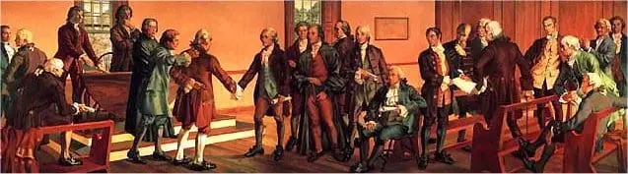
What should New York do?
A Problem-Based Inquiry into the Ratification of the new Constitution
Notes:
https://teachingamericanhistory.org/resource/newyork/

Slide 2
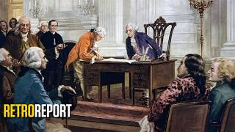

Slide 3
Discussion:
How did Enlightenment ideas influence the way the framers designed the Constitution?
Does that strengthen or weaken the Constitution?

Slide 4
Part 1
Notes:
https://teachingamericanhistory.org/resource/newyork/

Slide 5
The Decision - a Fictional Dramatization - The following conversation is invented for this activity. It represents arguments made during the ratification debate, but these are not John Jay’s exact words.
“Marcus, do you think New York should ratify it?” John Jay asks for the third time in ten minutes.
“We’ve only had the Articles of Confederation for 7 years. Do we really want or need something more binding?” (The meeting should be starting soon and most are wondering if we really need this new Constitution.)
“John, we’ve been over this. We don’t need a stronger government and a tyrannical leader. We just got rid of a king, and where are the rights for the people? I don’t know. This seems too powerful.”
“I disagree. Our current Union is but a fragile rope of sand, wholly incapable of shielding our commerce from foreign threats or domestic rebellion. Only under this new Constitution can our separate states bind themselves into a single, respectable nation, with the strength to endure. To reject this system is to invite invasion from foreign nations and anarchy at home."
“A rope of sand? Under the Articles, the states still control most of their own affairs. This Constitution would bind us much more closely to a powerful national government. What if that government turns against the principles of the Revolution?”
"We are one people on one continent, and breaking apart means our ruin. A divided America will crumble under foreign threats and local wars. The Union must be permanent if we want to survive."
“I will need to see a Bill of Rights. I don’t like it.”
"You do not understand the system we are building. The new government receives limited, listed powers. Supporters argue that it cannot lawfully exercise powers that the Constitution does not grant. You do not need a law saying you are allowed to wear a hat, so why demand a law saying you are allowed to speak? A list of rights is pointless when the government has no power to take them away in the first place."
The Convention is about to start and John has to leave. “Tell me why New York should not ratify this new Constitution.”
“I need protections from the government. No more kings in America. I say No!”

Slide 6
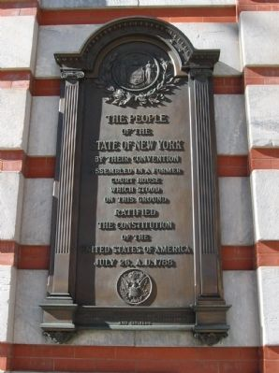
Your Situation in 1788
You are Marcus, a local Poughkeepsie resident, who has encountered an old friend John Jay on his way to the Courthouse on Market Street. You are hesitant to support the new Constitution because you distrust a strong central government. Jay seems confident that this is the right course of action.
You fought in the war in order to break from a powerful government that taxed and mistreated its colonists. As Jay leaves, you start questioning your stance.
“Could Jay be right? Do we need a stronger government? But what about the people? And what about taxes?”
As a New Yorker, what do you want your delegates to do?
Notes:
Image: https://www.hmdb.org/m.asp?m=37734

Slide 7

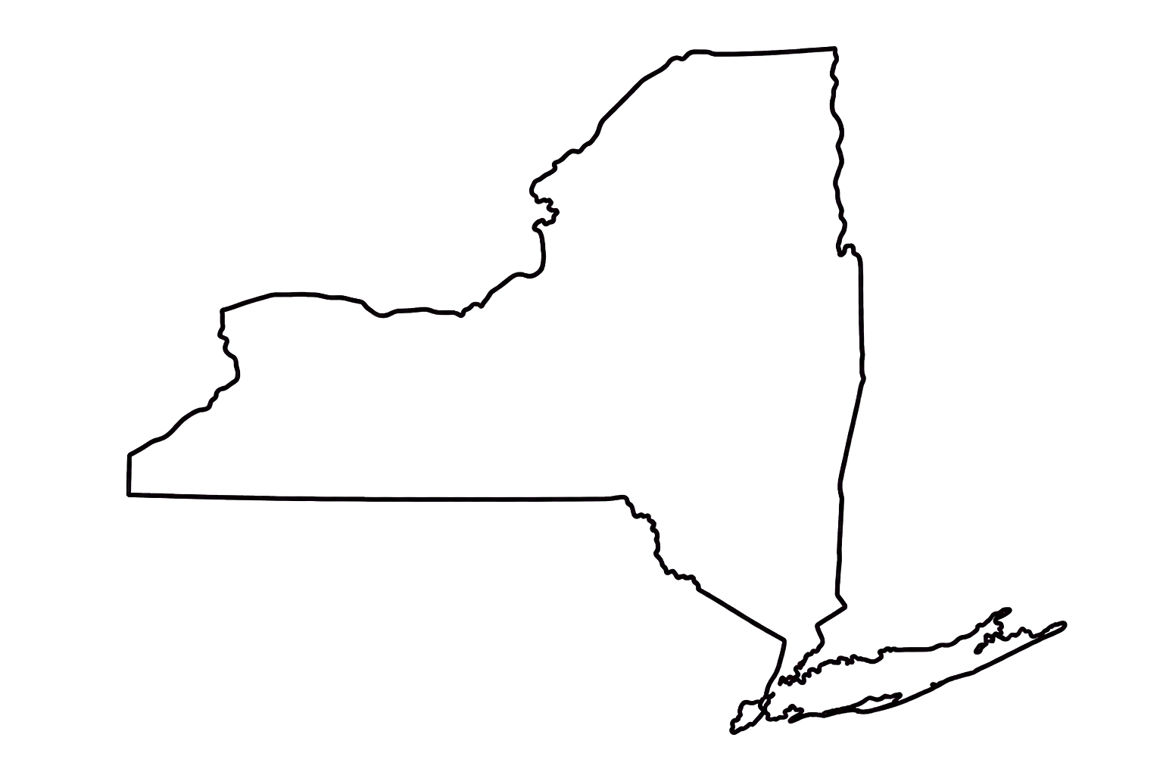
Identify the problem - List 3 important issues involved in the Ratification of the Constitution.
Why wasn’t there universal support for the new Constitution? What are the concerns of Marcus and/or John Jay?
Issue #1
Issue #2
Issue #3

Slide 8
Collaboration: With no more than two partners, begin thinking about what you would need to better understand the decision facing Jay and the other delegates. What do you need to know in order to feel safe with this new government?
Turn your issues from the last page into questions that need to be answered.
Question 1
Question 2
Question 3

Slide 9
Your stake in this problem stems from your colonial and veteran experiences.
How might you think about this problem differently as a student today and as a Revolutionary War veteran and taxpayer living in 1788?
As a student I think about …
As a Revolutionary War veteran and taxpayer in 1788 I would be considering…

Slide 10
Bias: personal prejudice in favor of or against one thing, person, or group compared with another.
Expert problem solvers frequently examine their own thinking. One thing they want to keep checking is their bias. Why is it important to know what biases a student might bring to an investigation?

Slide 11
Part 2
Notes:
https://teachingamericanhistory.org/resource/newyork/

Slide 12
Deepening Your Understanding of the Problem
Clearly state the question you need to answer in order to make the best decision. Sometimes the big question is too broad. Smaller questions can help us answer it.
What is the biggest question facing Marcus and John?
What two smaller questions would help them decide?

Slide 13
This works for your New York State Regents Short Essay Question
A Quick Note About Reliability…
Reliability: How useful is this document for understanding the speaker’s position?
Consider the speaker’s role, purpose, audience, and possible bias.
Support your answer with evidence from the document.

Slide 14
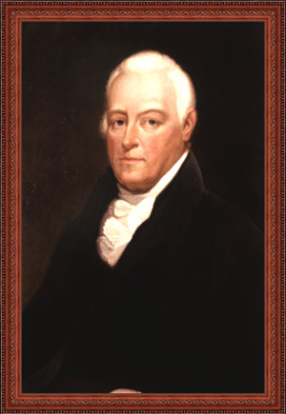
John Lansing Jr - a New York lawyer and public official who had served in the Continental Congress and attended the Constitutional Convention in Philadelphia. He later represented Albany County at the New York ratifying convention in Poughkeepsie.
Document A: John Lansing Jr., speech at the New York Ratifying Convention, June 20, 1788.
Audience: who was supposed to hear/read this document?
Purpose: What is the speaker trying to convince the audience to believe or do?
Position: What action does the speaker want New York to take? What evidence supports your answer?
Reliability: How useful is this document for understanding the speaker’s position? Consider the speaker’s role, purpose, audience, and possible bias.
Notes:
https://history.nycourts.gov/figure/john-lansing/

Slide 15
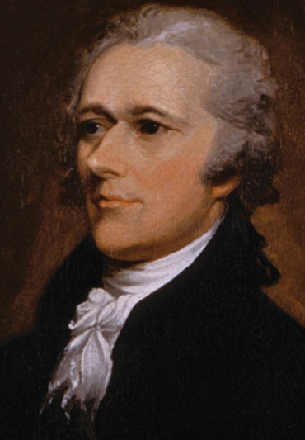
Alexander Hamilton - a Revolutionary War veteran, lawyer, and former aide to George Washington. He represented New York at the Constitutional Convention and became one of the most active speakers at the Poughkeepsie convention.
Document B: Alexander Hamilton, speech at the New York Ratifying Convention, June 21, 1788.
Audience: who was supposed to hear/read this document?
Purpose: What is the speaker trying to convince the audience to believe or do?
Position: What action does the speaker want New York to take? What evidence supports your answer?
Reliability: How useful is this document for understanding the speaker’s position? Consider the speaker’s role, purpose, audience, and possible bias.
Notes:
https://hvmag.com/life-style/alexander-hamilton-hudson-valley-history/

Slide 16
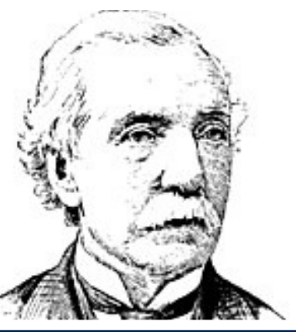
Melancton Smith - a merchant, lawyer, and former member of the Continental Congress. At the Poughkeepsie convention, he became known for his careful arguments about representation, political power, and the rights of ordinary citizens.
Document C: Melancton Smith, speech at the New York Ratifying Convention, June 20, 1788.
Audience: who was supposed to hear/read this document?
Purpose: What is the speaker trying to convince the audience to believe or do?
Position: What action does the speaker want New York to take? What evidence supports your answer?
Reliability: How useful is this document for understanding the speaker’s position? Consider the speaker’s role, purpose, audience, and possible bias.

Slide 17
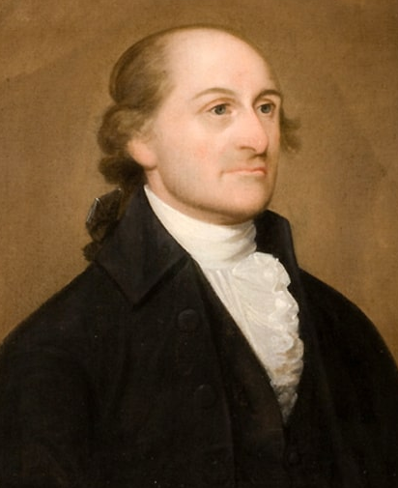
John Jay - a lawyer, diplomat, and former president of the Continental Congress. His experience managing the nation’s foreign affairs shaped his ideas about the powers and resources the United States government would need.
Document D: John Jay, speech at the New York Ratifying Convention, July 1, 1788.
Audience: who was supposed to hear/read this document?
Purpose: What is the speaker trying to convince the audience to believe or do?
Position: What action does the speaker want New York to take? What evidence supports your answer?
Reliability: How useful is this document for understanding the speaker’s position? Consider the speaker’s role, purpose, audience, and possible bias.

Slide 18
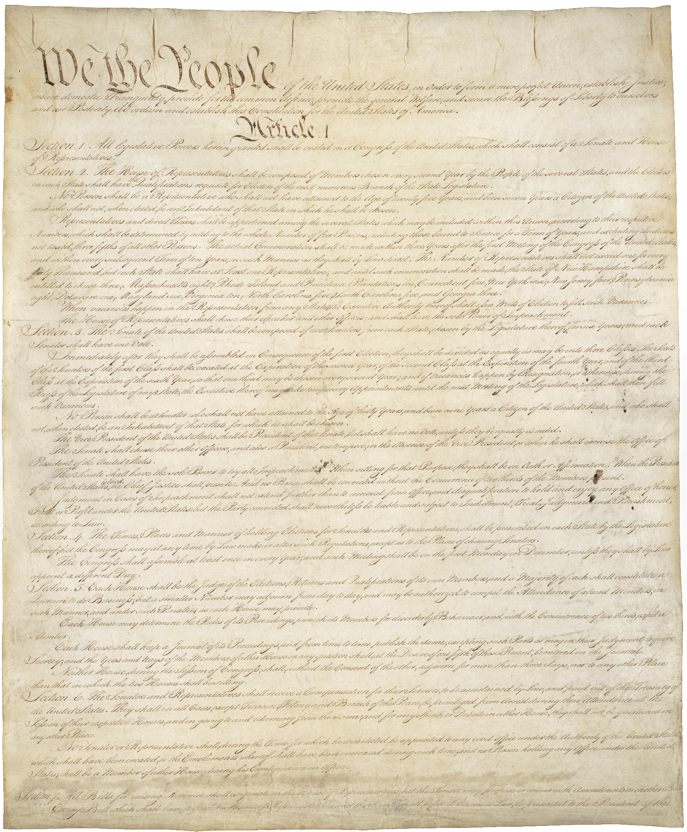
Summarizing what you’ve learned
Review the notes from your four sources. Answer one of your questions from Slide 12.
Remember to cite evidence from at least one document.
My Question:
My Summary:
Notes:
https://www.archives.gov/founding-docs/constitution

Slide 19
Part 3
Notes:
https://teachingamericanhistory.org/resource/newyork/

Slide 20
Choices, Choices, Choices - My suggestion to John Jay
Select and highlight one option.
Identify at least one positive and one negative outcome, and support your recommendation with evidence from at least two documents.
Ratify the Constitution as written Reject the Constitution Ratify while recommending amendments or protections
Potential Positive Outcomes | Potential Negative Outcomes

Slide 21
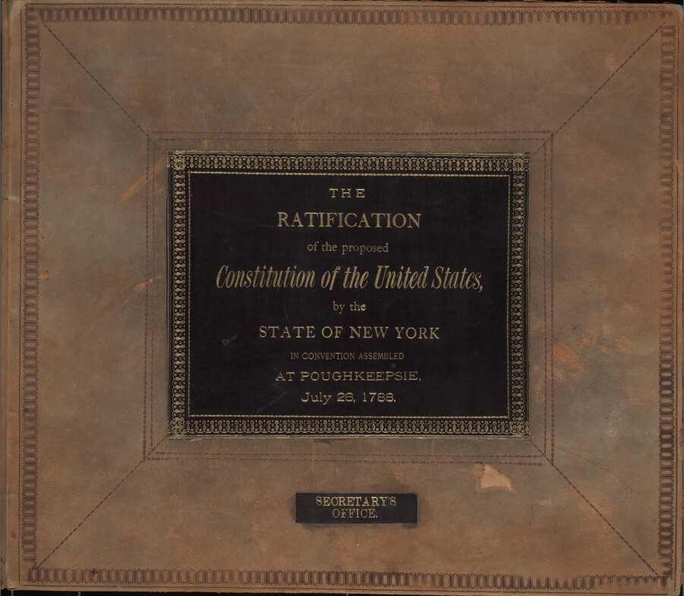
On July 26, 1788, New York ratified the Constitution by a vote of 30–27. The delegates also approved a declaration of rights, recommended amendments, and called for another convention to consider changes to the Constitution.

Slide 22
New York has ratified the Constitution. Write John Jay a two-paragraph letter evaluating the decision. Explain which concerns were addressed, which concerns remain, and whether you (Marcus) still agree with your original recommendation of “No” or have changed your stance? Use evidence from at least two documents. Sentence starters are provided on next slide.
Dear John,

Slide 23
Civic Literacy Statement Starters
Making a claim: New York should ___ because ___.
Using evidence: In Document __, ___ argues, “___.” This shows ___.
Explaining reasoning: This evidence matters because ___.
Comparing sources: Documents __ and __ agree that ___, but they disagree about ___.
Addressing another view: Some delegates may argue ___. However, ___.
Recommending an amendment: New York should recommend an amendment that ___.

Slide 24
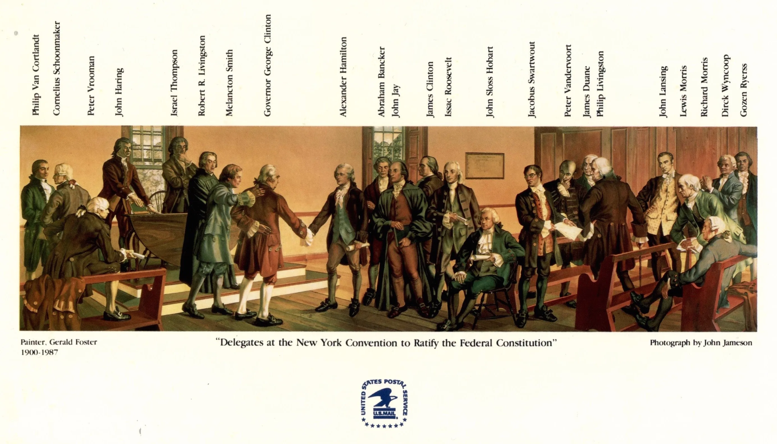
The People Behind the Debate
This later artistic reconstruction depicts delegates at the New York Ratification Convention. Several labeled delegates—including John Lansing Jr., Alexander Hamilton, Melancton Smith, and John Jay—are authors of the documents you examined during this inquiry.
The mural is inside the United States Post Office at 55 Mansion Street in Poughkeepsie, New York. It is displayed on the second-floor mezzanine of the main lobby, on the north wall.
Notes:
https://thestrawfoot.com/2020/03/15/searching-for-an-historian-researching-the-poughkeepsie-post-office-mural-of-the-ny-state-ratification-of-the-u-s-constitution-july-1788-painted-by-gerald-foster/#jp-carousel-12301

Slide 25
Sources and Credits
Elliot, Jonathan, ed. The Debates in the Several State Conventions on the Adoption of the Federal Constitution. 2nd ed. Vol. 2. Washington, DC: Printed by and for the Editor, 1836. Library of Congress. https://www.loc.gov/resource/llscdam.lled002/.
Foster, Gerald Sargent. Delegates at the New York Convention to Ratify the Federal Constitution. 1938. Mural. United States Post Office, Poughkeepsie, New York. Reproduced as the official poster of the New York State Bicentennial Commission; original mural information courtesy of the Franklin D. Roosevelt Presidential Library.
New York Ratifying Convention. “Amendments to the Constitution.” July 15, 1788. Founders Online, National Archives. https://founders.archives.gov/documents/Hamilton/01-05-02-0012-0069.
New York Ratifying Convention. “Circular Letter to the Governors of the Several States.” July 26, 1788. Founders Online, National Archives. https://founders.archives.gov/documents/Hamilton/01-05-02-0012-0101.
New York Ratifying Convention. “Extract from the Journal of the New York Ratifying Convention.” July 26, 1788. Founders Online, National Archives. https://founders.archives.gov/documents/Jay/01-05-02-0041.
Retro Report. “An Enlightened Idea: The Constitution Drew on Centuries-Old Principles.” Produced and edited by Matthew Spolar. May 21, 2026. Video, 5 min. https://retroreport.org/video/an-enlightened-idea-the-constitution-drew-on-centuries-old-principles/.
Rosenblatt, Albert M. “The Fateful Hour: The Ratification of the United States Constitution in Poughkeepsie, New York 1788.” The Green Bag 28, no. 1 (Autumn 2024). https://greenbag.org/archive/green_bag_tables_of_contents.html.
Stepien, William J., Peter R. Senn, and William C. Stepien. The Internet and Problem-Based Learning: Developing Solutions Through the Web. Zephyr Press, 2000.
United States Constitution. 1787. General Records of the United States Government, Record Group 11. National Archives, Washington, DC. https://www.archives.gov/founding-docs/constitution.

